Slide 1

Forensic Analysis of Linux and MAC System Artifacts

Slide 2
Operating Sytem
An operating system (OS) serves as the fundamental software that takes control upon its initial loading through a boot program, orchestrating the seamless execution of various application programs within a computer system. These application programs interact with the operating system by submitting service requests through a well-defined interface known as an application program interface (API). Furthermore, end users engage with the operating system directly, utilizing a user interface to facilitate interactions. This interface can take the form of a command-line interface (CLI), where text-based commands are employed, or a graphical user interface (GUI), offering a visual and intuitive means of interaction.

Slide 3
History Of Operating System
In 1956, two decades following the introduction of the Z1 computer that operated without an operating system, the initial operating system emerged, primarily aimed at managing tape storage.
Subsequently, Bell Labs pioneered UNIX, and marked the inception of the first multitasking operating system.
In 1985, Microsoft fused MS-DOS with a Graphics User Interface (GUI), which gave rise to an integrated computing experience.
As of October 2024, the latest iteration of Windows designed for personal computers and tablets is Windows 11 Pro, identified as version 21H2.

Slide 4
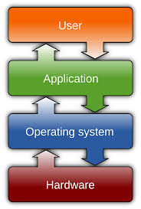
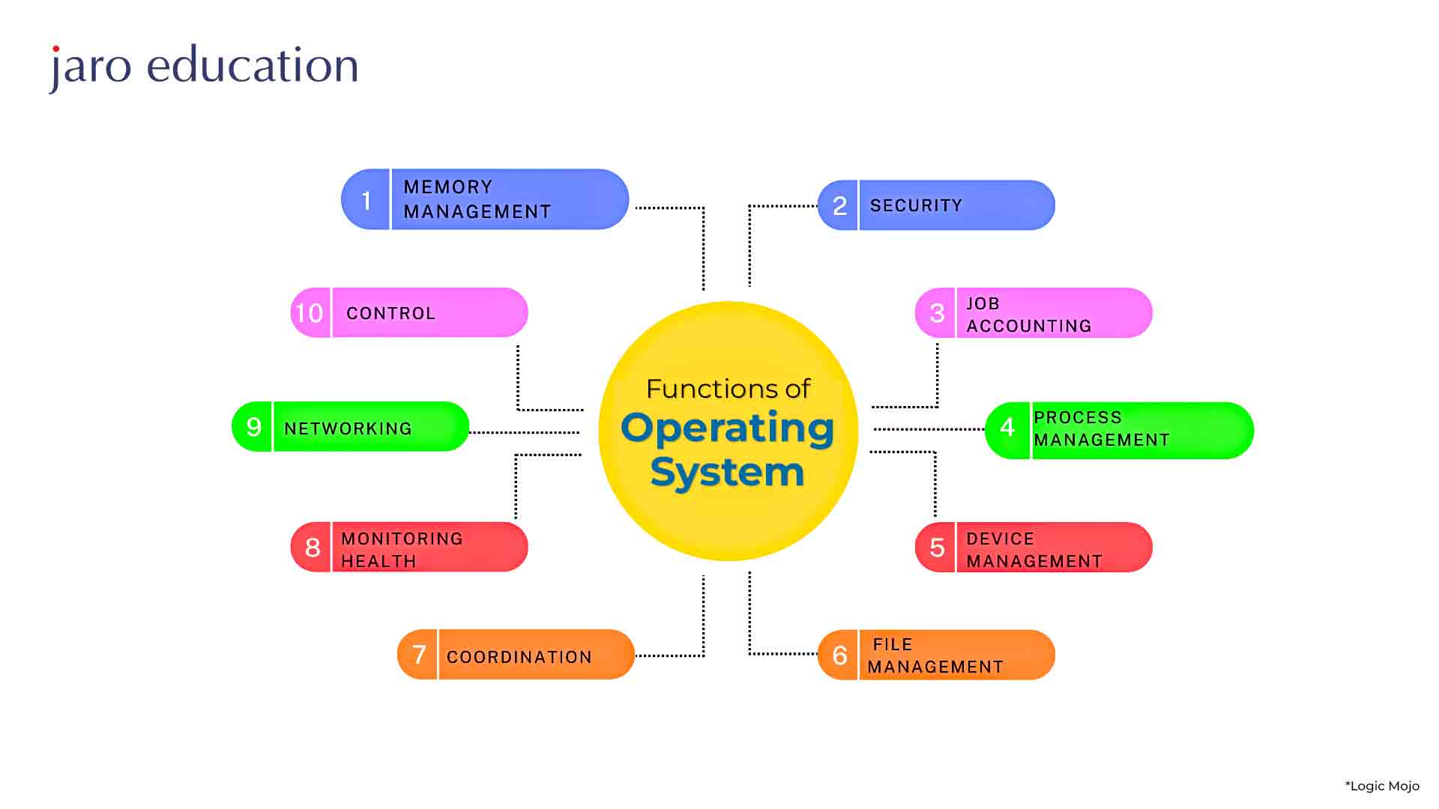
Operating Sytem

Slide 5
Processor Management
Within a multi-programming setting, the operating system assumes the responsibility of determining the sequence in which processes are granted access to the central processing unit (CPU) and allocating time for processing to each individual process. This role fulfilled by the operating system is formally referred to as Process Scheduling. Further, an operating system is responsible for managing the processor’s work by allocating different jobs to it and ensuring that each process is allotted an adequate amount of processing time to operate effectively.

Slide 6
Device Management
An operating system oversees the interaction with hardware devices through dedicated drivers. It undertakes the subsequent functions to manage devices:
Maintains a record of all linked devices within the system.
Designates an Input/Output controller which is responsible for the operation of each device.
Determines access privileges and time allocations for processes requesting device usage.
Efficiently allocates and effectively manages devices.
Releases devices when their use is no longer necessary.
Diverse input and output devices exist, and the operating system regulates their operation. It receives requests from these devices, executes specific tasks, and subsequently communicates the outcomes back to the requesting processes.

Slide 7
File Management
A file system is structured with directories to streamline navigation and utilization. These directories can encompass additional directories and files. Operating Systems execute the subsequent file management tasks:
Monitoring file locations, user permissions, file statuses, and related details.
Supervising organized records of file creation, deletion, transfer, duplication, and storage.
Safeguarding data integrity within files, including the directory arrangement, by thwarting unauthorized entry.

Slide 8
Features of Operating Systems
Serves as a foundation for executing applications
Manages memory and orchestrates CPU allocation
Offers an abstract approach to file systems
Facilitates networking capabilities
Implements security functionalities
Presents a user interface
Delivers system utilities and services
Takes care of application development support

Slide 9
I/O Device Management
An integral role of an operating system is to shield users from the unique intricacies of distinct hardware components. I/O Device Management achieves this by creating a higher-level abstraction of hardware devices, concealing intricate specifics from applications. This abstraction ensures the correct utilization of devices, safeguards against errors, and furnishes users with a user-friendly and effective programming environment.
Functions of I/O management:
Offers buffer caching system.
Provides general device driver code.
Provides drivers for particular hardware devices.

Slide 10
Network Management
Network management encompasses overseeing and governing computer networks. This involves tasks like monitoring performance, diagnosing faults, provisioning network resources, and upholding service quality.
Functions of Network Management:
Network management encompasses several key tasks, including configuring network equipment and connections, monitoring performance, and managing faults. Furthermore, security and accounting also constitute integral aspects of network management functions. While a majority of management activities are carried out using a centralized system hierarchy, specific functions such as recovering from failures or utilizing defect indicators to mitigate alarms, are executed in a decentralized manner.

Slide 11
Main Memory Management
Main Memory constitutes an expansive arrangement of storage units, each associated with a unique address. Memory management involves orchestrating a series of read or write operations targeted at specific memory addresses.
Main memory is a versatile and volatile form of storage mechanism. Comprising a substantial series of bytes and addresses, it serves as a temporary repository for volatile information. Commonly known as Random Access Memory (RAM), Whenever computer routines are initiated, they find a temporary abode in the primary memory for processing. Subsequently, users have the option to preserve data
Functions of Main Memory Management:
It helps to track primary memory.
De-allocates the memory when a process no longer requires it or has been terminated.

Slide 12
Security Management
To safeguard processes within an operating system, it becomes imperative to shield them from potential interference by others. This necessitates the implementation of diverse mechanisms, aiming to validate that processes seeking to access hardware resources such as files, memory, and CPU and possess the appropriate authorization granted by the operating system.

Slide 13
Secondary Storage Management
Free space management.
Storage allocation.
Disk scheduling
Command Interpreter System
An integral element within an operating system is its command interpreter, serving as the pivotal link connecting the user with the system’s functionalities.
The command interpreter functions by executing user commands,

Slide 14
32-bit OS versus 64-bit OS
A 64-bit processor surpasses a 32-bit processor in capability due to its ability to process larger amounts of data simultaneously. With a 64-bit processor, there’s increased capacity to hold computational values, such as memory addresses, resulting in access to over four billion times the physical memory compared to a 32-bit processor. One other notable distinction between 32-bit processors and 64-bit processors lies in their computational speed, impacting the rate at which tasks can be accomplished.

Slide 15
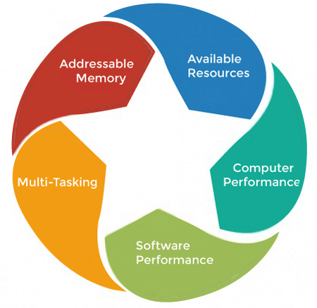

Slide 16
MAC File-system and Artifacts
Introduction to MAC OS
macOS is an operating system designed by Apple for its Mac computers. It is based on UNIX, making it secure, stable, and efficient.
In 1984, Apple introduced the Macintosh PC with the mac os
Apple name its OS as “Mac OS”,beginning in 1997 which was previously known as “System”.

Slide 17
Key Features:
Graphical User Interface (GUI): A user-friendly interface designed for ease of navigation.
Built-in Security: Features like Gatekeeper, SIP (System Integrity Protection), and FileVault ensure high-level data protection.
Cross-Device Integration: Works seamlessly with iPhones, iPads, and other Apple devices using features like Handoff and Universal Clipboard.

Slide 18
File System
1. File System Overview
A file system organizes and manages how data is stored and retrieved on a disk. In macOS, APFS (Apple File System) is the default file system.
APFS replaces the aging HFS+ (Hierarchical File System Plus) that had been in use for many years. APFS is designed to offer improved performance, reliability, and security, especially in the context of modern storage technologies and computing environments. Here are some key features and aspects of APFS

Slide 19
APFS (Apple File System)
1.Space Sharing:
Multiple volumes can dynamically share available storage space instead of being fixed to specific sizes.
Example: If you have two volumes on a 500 GB drive, one volume can use 400 GB, and the other can use 100 GB if needed.
2.Snapshots:
A snapshot is a read-only copy of the file system at a particular moment.
Use Case: Time Machine uses snapshots to back up data, allowing users to restore files to a previous state.

Slide 20
3.Crash Protection (Copy-on-Write):
Data changes are written to a new location before updating metadata, ensuring that the system remains stable in case of a crash.
Example: While editing a file, the original remains untouched until the new version is saved successfully.
4.Native Encryption:
APFS supports full-disk encryption and per-file encryption.
Example: FileVault uses this feature to secure macOS drives.
APFS uses the XTS-AES-128 encryption algorithm

Slide 21
5.Cloning:
Creates a copy of a file or directory without duplicating data until changes are made.
Example: If you duplicate a 1 GB file, no extra space is used unless you modify the duplicate.
6.Sparse File Support:
APFS supports sparse files, which are files that have large amounts of unallocated space within them. This is beneficial for applications that use large data sets with portions of empty or zeroed data.

Slide 22
7. Optimized for Flash/SSD Storage:
APFS is optimized for modern storage technologies, particularly flash storage and solid-state drives (SSDs). It includes features that take advantage of the performance characteristics of these storage devices, such as efficient space allocation and improved read and write performance.

Slide 23
Important Directories
1. Root Directory /: -/system,/users
2. /System Directory - Store core macos files
3. /Users
4. /library
5. /tmp
6. Hidden Directories:
Directories starting with a dot (e.g., .bash_profile).
Often used for configuration files or system processes.
Command: Use ls -la in the terminal to view hidden files.

Slide 24
Booting Process
1. Power-On Self-Test (POST):
Performed by the BootROM to check hardware.
Example: Ensures the CPU, RAM, and peripherals are functional.
2. EFI (Extensible Firmware Interface):
Similar to BIOS in Windows but more advanced.
Loads drivers and initializes hardware for macOS to start.
3.Kernel Initialization:
The kernel (core of macOS) starts. It manages hardware like memory and CPU.
Loads drivers and mounts the APFS root file system.
4.launchd:
The first system process to start.
Manages all other processes, like login screens and background tasks.

Slide 25
Boot Example
When you turn on a MacBook:
The Apple logo appears (indicating the kernel is loading).
The login screen appears (managed by launchd).
After logging in, your desktop and apps load.

Slide 26
Important Hidden Directories
/etc: Stores network settings like the hosts file.
/usr: Holds command-line tools and system utilities.
/var: Contains logs, temporary files, and system data.
/private: Stores links to /tmp and /var.
* ls -la /

Slide 27
System Services in macOS
System services in macOS are background processes and components that ensure the operating system and applications function smoothly. They handle critical tasks such as user authentication, hardware management, scheduling, and system monitoring.

Slide 28
a. Core Services
launchd: Manages the initialization of services and processes.
kextd: Loads kernel extensions (drivers).
notifyd: Manages notifications between applications.
b. Hardware Management
powerd: Manages power-related events like sleep, wake, and battery usage.
airportd: Handles Wi-Fi connections.

Slide 29
c. User Services
Services specific to the logged-in user.
cfprefsd: Manages user preferences and settings.
tccd: Handles app permissions for accessing data like location, contacts, and files.

Slide 30
Forensic Acquisition and Analysis of Plists
Property List Files:
XML or binary files storing app and system settings.
Examples:
com.apple.finder.plist: Tracks recently accessed folders.
com.apple.recentitems.plist: Logs recent apps and documents.

Slide 31
#Tools for Analysis
plutil: A built-in tool to view plist files.
plutil -convert xml1 com.apple.finder.plist
Third-Party Tools: Tools like PlistViewer or macOS Forensic Toolkit.

Slide 32
File vault and key chain
FileVault: Full-Disk Encryption
FileVault is macOS's built-in disk encryption feature that protects the entire storage drive.
1.Full-Disk Encryption (FDE):XTS-AES-128 algorithm with a 256-bit key.
2.Encryption at Rest:
The data is encrypted when stored on disk and decrypted on-the-fly when accessed.

Slide 33
3.Integration with Login Credentials:
A user’s login password is tied to the decryption key, ensuring seamless authentication.
4.Recovery Key:
A recovery key is generated during FileVault setup to regain access if the login password is forgotten.

Slide 34
Keychain: Credential and Secure Data Management
Keychain is macOS's built-in password manager and secure storage system. It securely stores:
Passwords for applications, websites, and Wi-Fi networks.
Encryption keys and certificates.
Secure notes.

Slide 35
Key Features of Keychain
1.Centralized Storage:
One place to manage all credentials and sensitive information.
2.Encryption:
Data is encrypted using the AES-256 algorithm.
3.Auto-Fill:
Automatically fills in stored credentials in web browsers and apps.

Slide 36
4.Multiple Keychains:
System Keychain: For system-wide credentials (e.g., root certificates).
Login Keychain: Tied to the user’s login password.
5.Synchronization with iCloud:
Synchronizes credentials across Apple devices using iCloud Keychain.

Slide 37
Feature | FileVault | Keychain
Purpose | Encrypts entire disk. | Stores passwords and secure data.
Scope | Protects all files on the disk. | Manages specific credentials and keys.
Encryption | Full-disk AES encryption. | Item-specific AES encryption.
Access Control | Requires login credentials or recovery key. | Requires user authentication.
Forensic Challenge | Difficult to bypass without credentials. | Keychain files need credentials to access.

Slide 38
Linux File-system and Artifacts
Linux is an open-source, Unix-like operating system
widely known for its stability, security, and flexibility
used in various from desktop systems to servers, mobile devices, and embedded systems.
Linux is free to use, and its source code is open to the public
It can run on 32bit and 64bit os

Slide 39
Key Features of Linux:
Open Source
Multi-user
Multitasking
Portability
Networking
Performance
Command-Line and GUI

Slide 40
Linux OS Architecture
Hardware
Kernel
System Libraries(Programs)
System Utilities(file management, process control, system monitoring, and network administration)-ls,cp,ps
User Space(cli/gui)

Slide 41
Basics of Linux file-system
Linux file system is a hierarchical structure
Windows,(e.g., C:\, D:\), Linux follows a single-rooted directory a /.
/ (Root directory): The top-level directory, from which all other directories branch.

Slide 42
The main types of files in Linux include:
Regular files: These are the usual files that store data, such as text files, images, and executable files.
Directories: These are special files that store information about other files and directories.
Special files:
Block files: Used for devices that handle data in blocks (e.g., hard drives).
Character files: Used for devices that handle data one character at a time (e.g., terminals).

Slide 43
File Permissions:
Each file in Linux has permissions that determine who can read, write, or execute the file. These permissions are divided into three categories:
Owner: The user who owns the file.
Group: A set of users grouped together.
Others: Everyone else.
Each file permission can be one of the following:
r (read): Permission to read the file.
w (write): Permission to modify the file.
x (execute): Permission to execute the file (if it's a program or script).

Slide 44
Inodes:
Every file in Linux is represented by an inode. An inode is a data structure that contains metadata about a file, such as:
File type
Permissions
Owner and group
File size
Creation, modification, and access times
Pointers to the data blocks where the file's content is stored

Slide 45
Mounting:
In Linux, different file systems (e.g., hard drives, external devices, or network drives) are mounted into the directory tree. When you mount a device or partition, it is attached to a specific directory, making it part of the overall file system. The root file system is mounted at /, and other file systems may be mounted at other points (e.g., /home, /mnt).

Slide 46
Common Linux Directories and Their Functions
/ (Root):
The root directory is the top-level directory of the entire file system. All other directories are contained within it.
2. /bin:
Contains essential binary executables (programs) that are required for the system to boot and operate in single-user mode. For example, ls, cp, mv.
3. /sbin:
Contains system binaries for administrative tasks. These are programs typically used by the system administrator (root user), such as fdisk, reboot, and ifconfig.

Slide 47
4./etc:
Contains configuration files that control system settings. Files here define system-wide settings for the shell, networking, user management, etc. Examples include /etc/passwd (user information) and /etc/fstab (filesystem mounting).
5. /dev:
Contains device files, which represent hardware devices (e.g., /dev/sda for a hard disk, /dev/tty1 for a terminal). These files allow programs to interact with hardware devices.

Slide 48
6. /home:
This is where user directories are stored. Each user typically has a subdirectory here (e.g., /home/john), where personal files and configurations are stored.
7. /lib:
Contains essential shared libraries and kernel modules that are required for basic system operation. These libraries are used by programs in /bin and /sbin.

Slide 49
8./tmp:
Contains temporary files that are created by applications or users, which may be deleted on reboot or periodically.
9./var:
Contains files that are expected to change frequently during the system's operation, such as log files (/var/log), spool directories for printing (/var/spool), and caches.

Slide 50
10. /usr:
Contains user-related programs, libraries, and documentation that are not essential for the system to boot. It's divided into subdirectories:
/usr/bin: Most user commands.
/usr/lib: Shared libraries for binaries in /usr/bin.
/usr/share: Architecture-independent data (e.g., documentation, man pages)

Slide 51
Types of file system
1. ext4 (Fourth Extended File System)
Key Features:
Supports large file sizes and volumes (up to 16 TiB file sizes and 1 EiB volumes).
Faster file system checks due to journaling.
Extends support for metadata checksums, which improves data integrity.
Backward compatibility with ext3 and ext2.
Uses journaling to track changes, making it more robust against crashes.
Usage: Ext4 is the default file system for most modern Linux distributions It is ideal for general-purpose file storage, including both desktop and server environments.

Slide 52
2.ext3 (Third Extended File System)
It introduced journaling, which logs changes to the file system, reducing the risk of file system corruption after a crash or power failure.
Key Features:
Journaling improves the reliability of the file system.
Compatible with ext2, meaning ext3 can be mounted as ext2 if journaling is turned off.
Less efficient than ext4 in terms of performance and features.
Supports up to 2 TiB of file size and 16 TiB of volume size.

Slide 53
3. ext2 (Second Extended File System)
Key Features:
No journaling, which means fewer writes to disk, and thus faster in certain conditions.
Basic file system, simple design, and widely supported.
Maximum file size is 2 TiB, and maximum volume size is 32 TiB.
Suitable for flash drives, non-critical partitions, or older systems.

Slide 54
